Slide 1
Contenu storyboard (ppt) & storyline (lien web pour demo)
Les 3 slides suivants sont extraits d’un module basé sur un scénario qui sert de fil conducteur au module et à la théorie à partager avec l’apprenant
on y trouve des slides de scenario (slide 2 du ppt), des slides de théorie et d’activités (slides 3-4 du ppt)
Le storyboard ppt :
utilise le slide lui-même qui est une idée du rendu réel du module tel que visualisé en amont au moment de la création du storyboard
La partie notes intègrent toutes les consignes et explications liées au contenu à presenter, ainsi que le texte des voix offs
Voici le lien vers la version storyline des slides présentés ici:
https://scorm.galac.xyz
Katia LOTTE

Slide 2


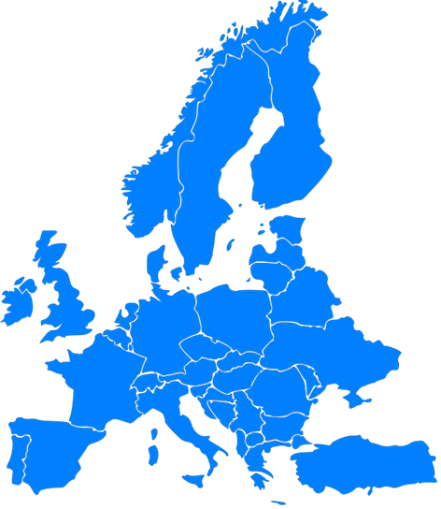

Red paint for red cars
Click on the icons as they appear.
Bill Hammer buys paint for VOX (a worldwide vehicle manufacturer).
His biggest spend = red paint
VOX factories
VOX Göteborg (Sweden) produces 300,000 cars per year
VOX main suppliers
GERMAN PAINT
= 200 tons of paint sold to VOX annually
= 10,000 tons annual production capacity
CZECH PAINT
= 150 tons of paint sold to VOX annually
= 10,000 tons annual production capacity
VOX Monfalcone (Italy) produces 200,000 cars per year
VOX Tarragona (Spain) produces 100,000 cars per year
FRENCH PAINT
= 180 tons of paint sold to VOX annually
= 10,000 tons annual production capacity
Notes:
Display slide title and map of Europe, and the intro sentence & launch VO1: Bill Hammer works at VOX, a worldwide vehicle manufacturer. He buys all the paint required for his company. His biggest spend is for red paint.
Display instruction inviting user to click on the 3 factory icons which have appeared on map (Sweden, Spain, Italy) in addition to the corresponding map legend (factory icon = VOX factories) & launch VO2: VOX has three main factories in Europe. In Sweden, Spain and Italy. Mouse over each factory icon for more information.
User mouse overs displays corresponding information.
Display map legend (person icon = VOX suppliers) at the same time as the 3 supplier icons appear on the map. Launch VO3: Bill Hammer buys a total of 7,000 tons of red paint from 15 companies spread all over Europe. His main quality problem is due to the fact that the red colour is not completely identical from one supplier to another. Here are his 3 biggest European suppliers who have a production capacity of ten thousand tons.

Slide 3




How to consolidate
Mouse over the 2 paint pots.
Bill decides to concentrate his purchases for VOX’s 2 South American plants.
The 2 plants independently buy a total of 7,000 tons of paint from several suppliers.
Goal: consolidate these purchases on 2 suppliers ( 3,000 tons for one supplier, 4,000 tons for the other)
*GERMAN PAINT & CZECH PAINT are present in South America.
= 1,000-ton portion of the supplier’s potential volume capacity (capacity can be free or allocated to other customers)
= 1,000-ton portion of the total volumes VOX buys
Click on the 2 suppliers on which to consolidate the volumes:
RIO PAINT
CZECH PAINT
CHILE PAINT
VOX BRAZIL
VOX CHILE
GERMAN PAINT
Notes:
Display slide title, instruction 1 (Watch the animation.), scenario paragraph & launch the VO with underlined VO text synced with corresponding illustration+text display.
VO: Bill Hammer decides to concentrate his purchases for his 2 VOX South American plants, in Brazil and Chile. By chance, GERMAN PAINT and CZECH PAINT are both present in South America. The 2 plants independently buy a total of 7000 tons of paint from several suppliers. Bill intends to consolidate the purchase of 7000 tons on 2 suppliers only; 3,000 tons for one supplier, 4,000 tons for the other. Which 2 suppliers should be selected to consolidate volumes?
The GOAL text box appears when mentioned by VO + display of 2 paint illustrations & the instruction inviting the user to mouse over them (which displays the corresponding info bubble explanation)
When VO ends, display activity elements (the 2 extra sites – Chile & Rio text & corresponding paint pots, and connecting arrows) & instruction inviting user to select the 2 suppliers to answer the question.
The correction process is automatic – the fact of clicking on an answer automatically launches the corresponding VO.

Slide 4

How to consolidate
CORRECTION
Click on the sound icons which appear.
Bill decides to concentrate his purchases for VOX’s 2 South American plants.
The 2 plants independently buy a total of 7,000 tons of paint from several suppliers.
Goal: consolidate these purchases on 2 suppliers ( 3,000 tons for one supplier, 4,000 tons for the other)
*GERMAN PAINT & CZECH PAINT are present in South America.
Click on the 2 suppliers on which to consolidate the volumes:
RIO PAINT
CZECH PAINT
CHILE PAINT
VOX BRAZIL
VOX CHILE
GERMAN PAINT
Notes:
WRONG ANSWER SCENARIO:
User clicks on GERMAN PAINT+CZECH PAINT
Display RED CROSS & launch GERMAN & CZECH VO: This is not reasonable as you’d be filling their production capacity. They probably can’t take over such volumes which would be too big for them. In addition, they are probably engaged with other clients who they can’t or won’t quit easily.
Then display the correct answers (RIO+CHILE) & launch VO RIO PAINT & CHILE PAINT: This is the only solution possible. Your volumes would occupy 30 to 40 percent of their production capacity, which is already massive. And make sure they have other production lines and businesses; because it is never recommended to exceed 20 percent of a supplier’s turnover.
User clicks on GERMAN PAINT+RIO or CHILE PAINT or CZECH PAINT+ RIO or CHILE PAINT
Display RED CROSS on GERMAN or CZECH (answer chosen by user) + GERMAN & CZECH VO: This is not reasonable as you’d be filling their production capacity. They probably can’t take over such volumes which would be too big for them. In addition, they are probably engaged with other clients who they can’t or won’t quit easily.
Then display the correct answers (RIO+CHILE) & launch VO RIO PAINT & CHILE PAINT: This is the only solution possible. Your volumes would occupy 30 to 40 percent of their production capacity, which is already massive. And make sure they have other production lines and businesses; because it is never recommended to exceed 20 percent of a supplier’s turnover.
----------------------------
CORRECT ANSWER SCENARIO:
User clicks on RIO PAINT+CHILE PAINT
Green ticks + VO RIO PAINT or CHILE PAINT: This is the only solution possible. Your volumes would occupy 30 to 40 percent of their production capacity, which is already massive. And make sure they have other production lines and businesses; because it is never recommended to exceed 20 percent of a supplier’s turnover.

